Slide 1

Cooking recipe sharing Website
Nguyen Thanh Bao – 24CE005 (Leader)
Nguyen Thanh Nhan – 24CE051

Slide 2


TABLE OF CONTENTS
01
02
Introduction
Main Features
Conclusion & Future Development
03
04
Page Design Overview
Notes:
Note: you can add between 3 and 6 sections, the structure can vary. The numbers have to be kept

Slide 3

01
Introduction
Cooking recipe sharing Website

Slide 4
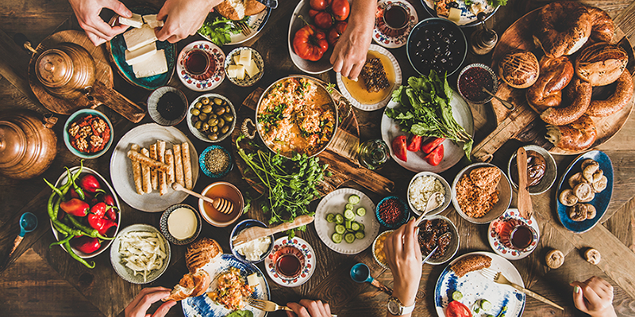


Many people love cooking, but they have difficulty finding recipes.
Notes:
There are many delicious dishes around the world, and as someone who loves cooking, I noticed that many people find it hard to search for simple and clear recipes. Whether a beginner or an experienced cook, there’s a need for a place where people can easily find and share recipes.

Slide 5

The goal is to create a cooking website that makes it easy for users to discover and follow recipes.
Notes:
That's why our team aims to create a website where users can:
+ Search for cooking recipes.
+ View detailed cooking instructions.

Slide 6
02
Main Features
Cooking recipe sharing Website

Slide 7
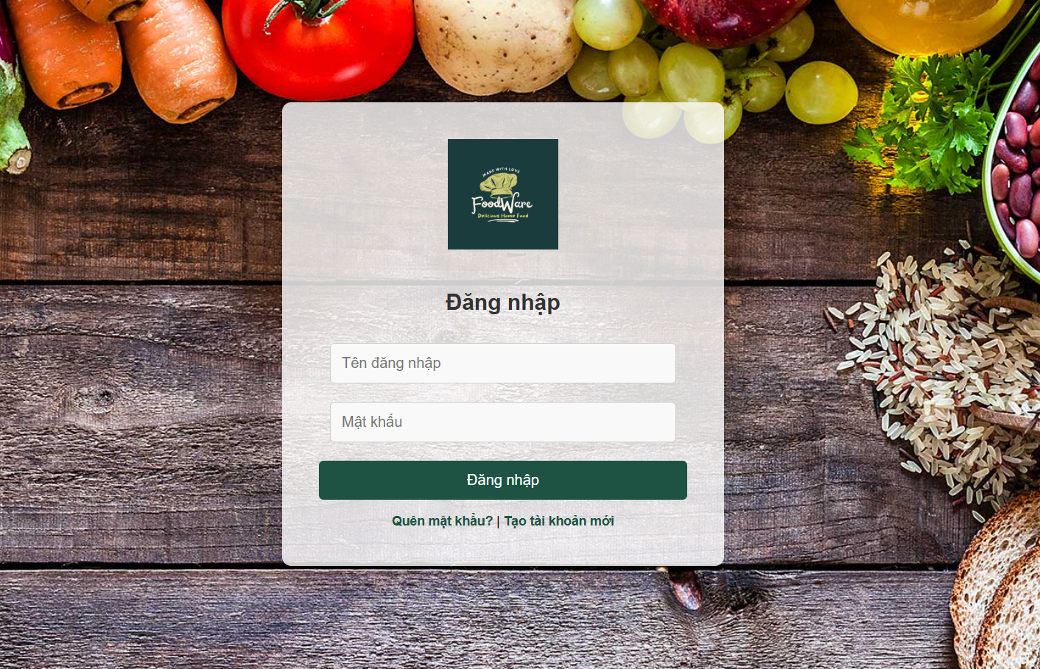
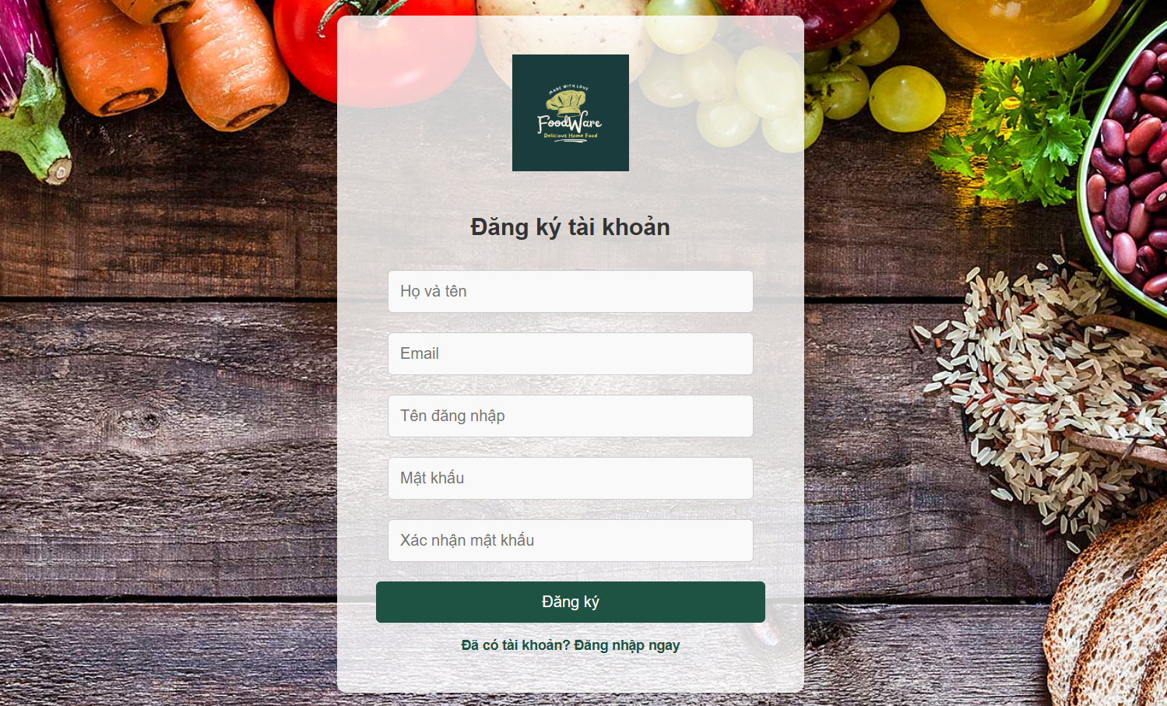
Main Features – User Account and Interaction
User Registration & Login
Notes:
User Registration & Login
Users can create an account and log in to save their favorite recipes.

Slide 8
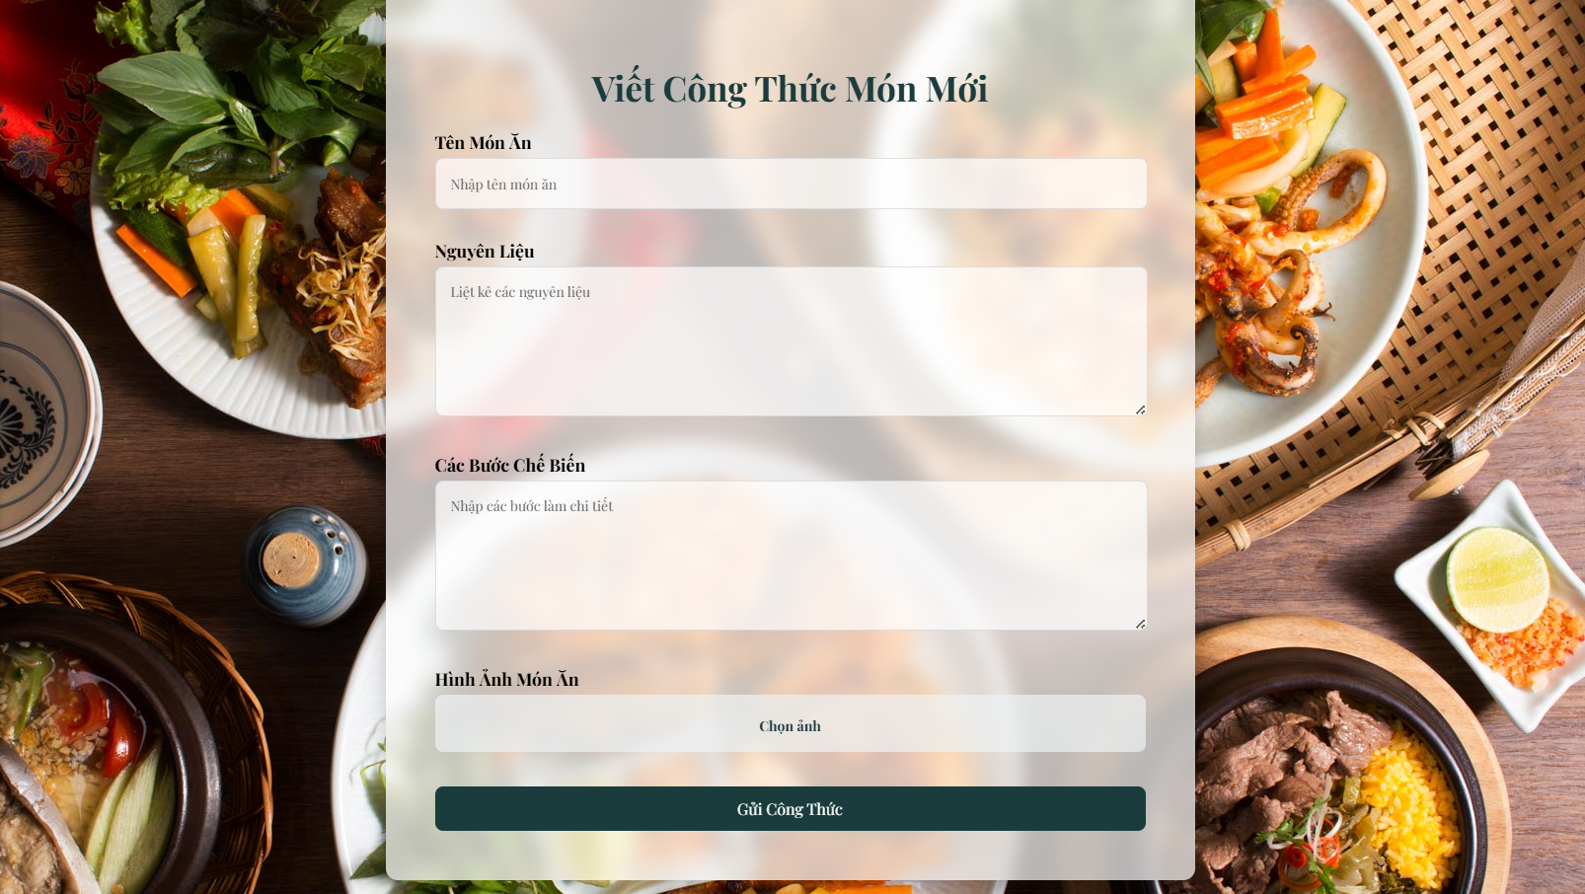
Main Features – User Account and Interaction
Create and Share Recipe
Notes:
Create and Share Recipes
Users can easily create their own recipes and share them with others.

Slide 9
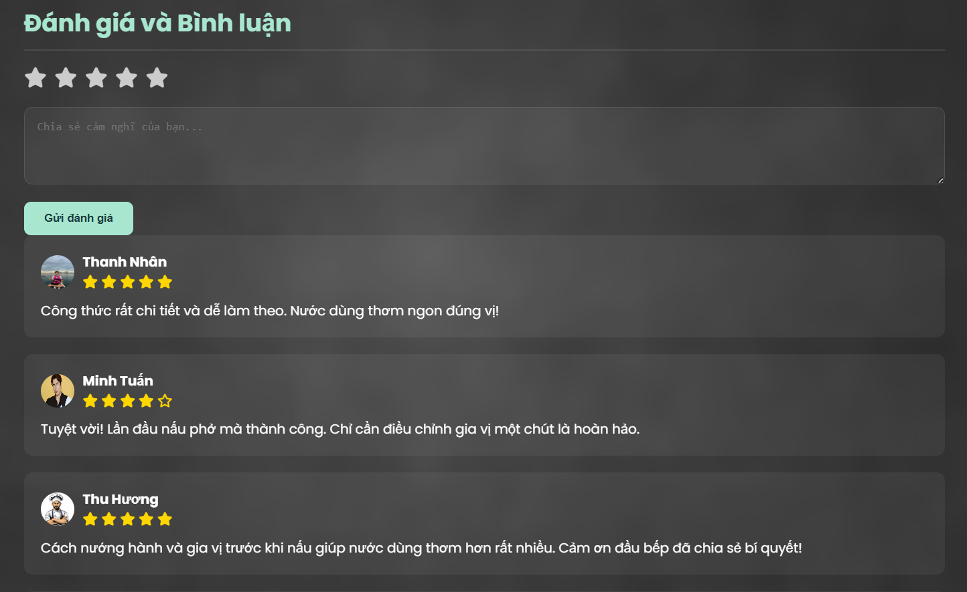
Main Features – User Experience
Recipe Ratings & Comments
Notes:
Recipe Ratings & Comments
Users can rate and comment on recipes to provide feedback or share tips.

Slide 10
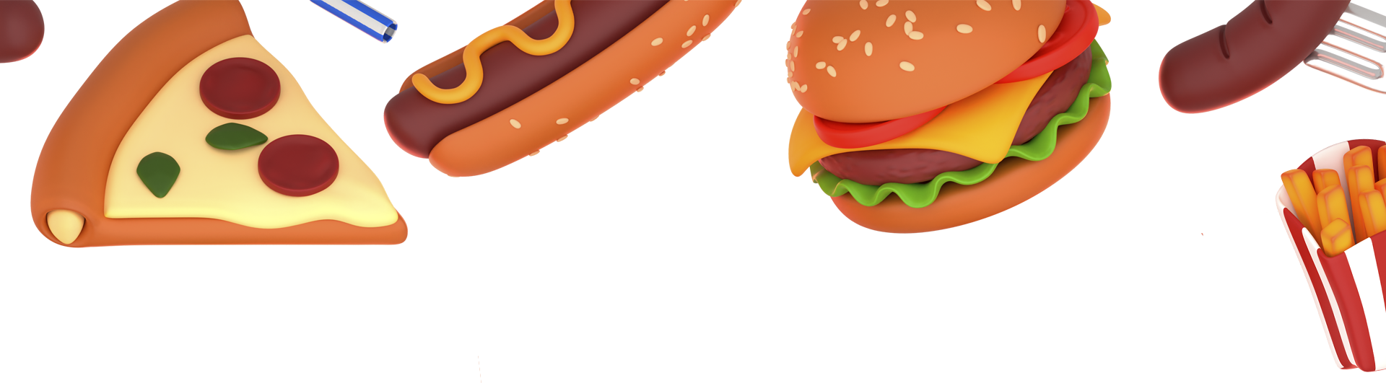
03
Page Design Overview

Slide 11
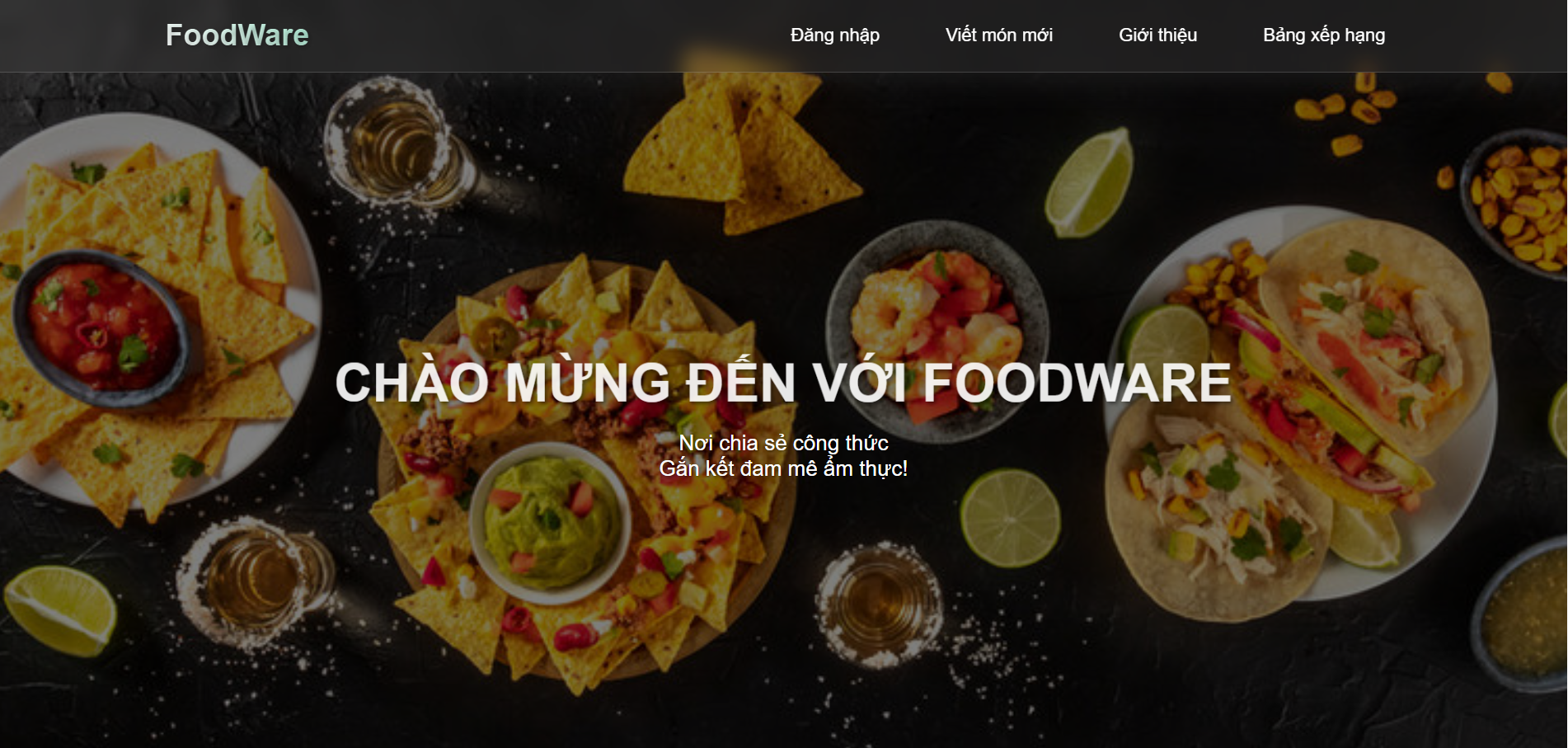
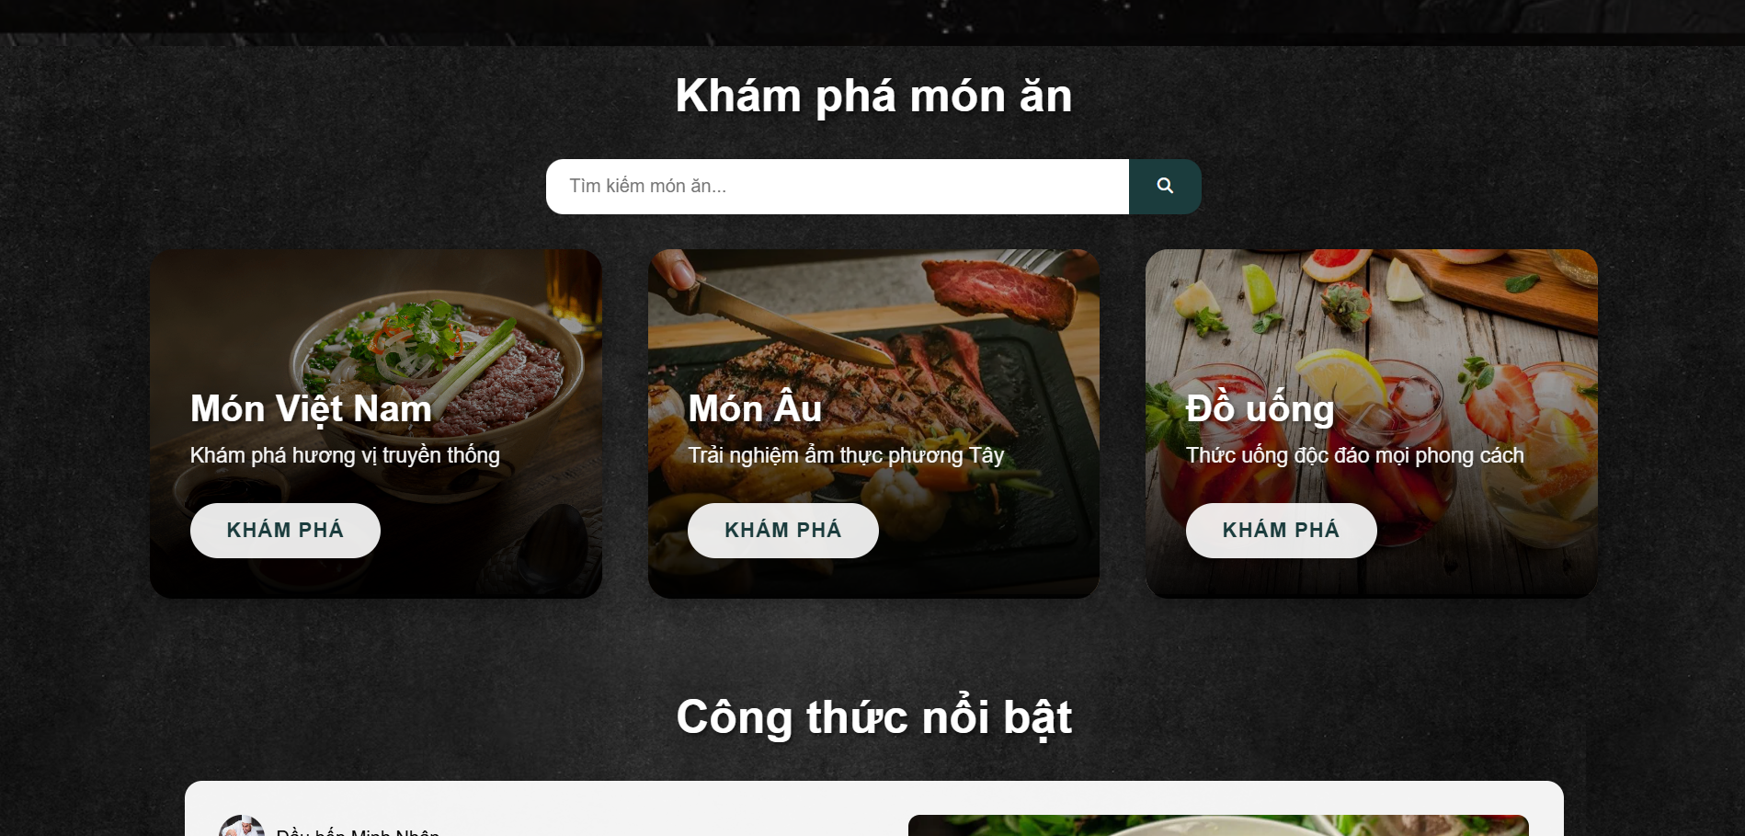
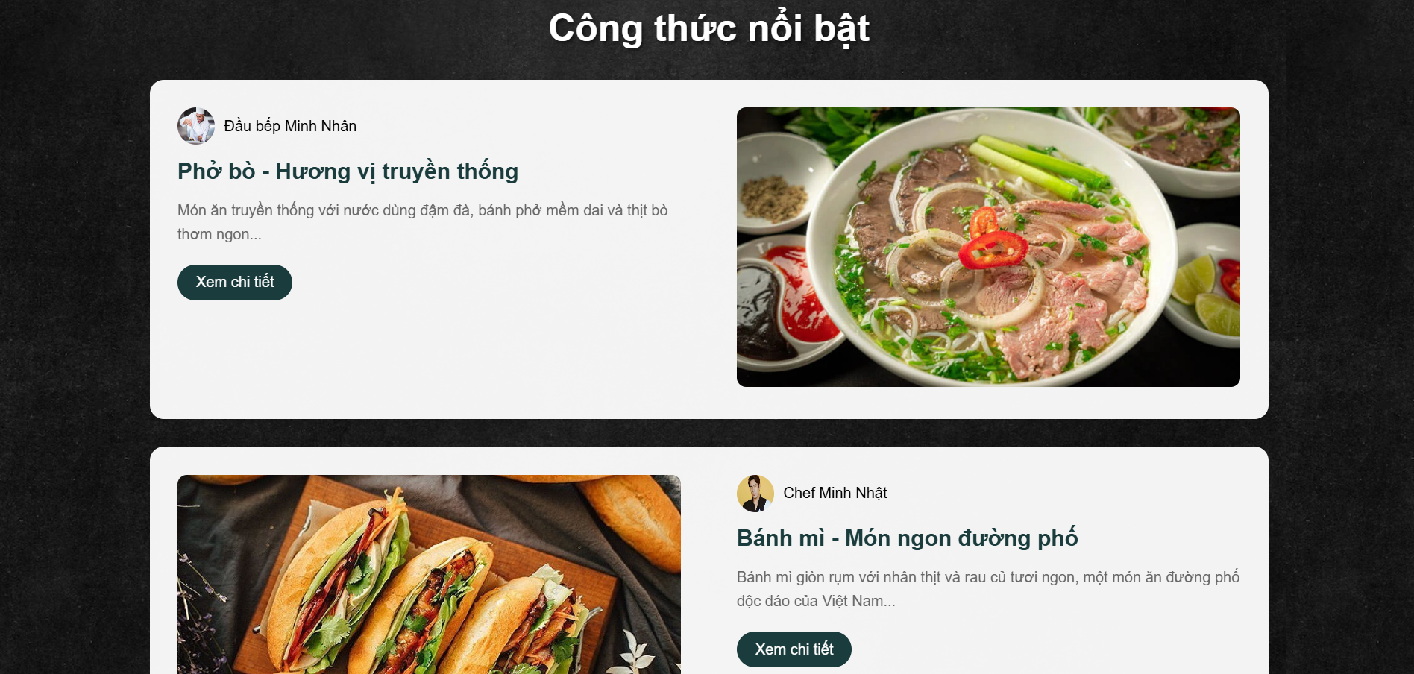
Homepage displays welcome message, search bar, and food categories,...

Slide 12
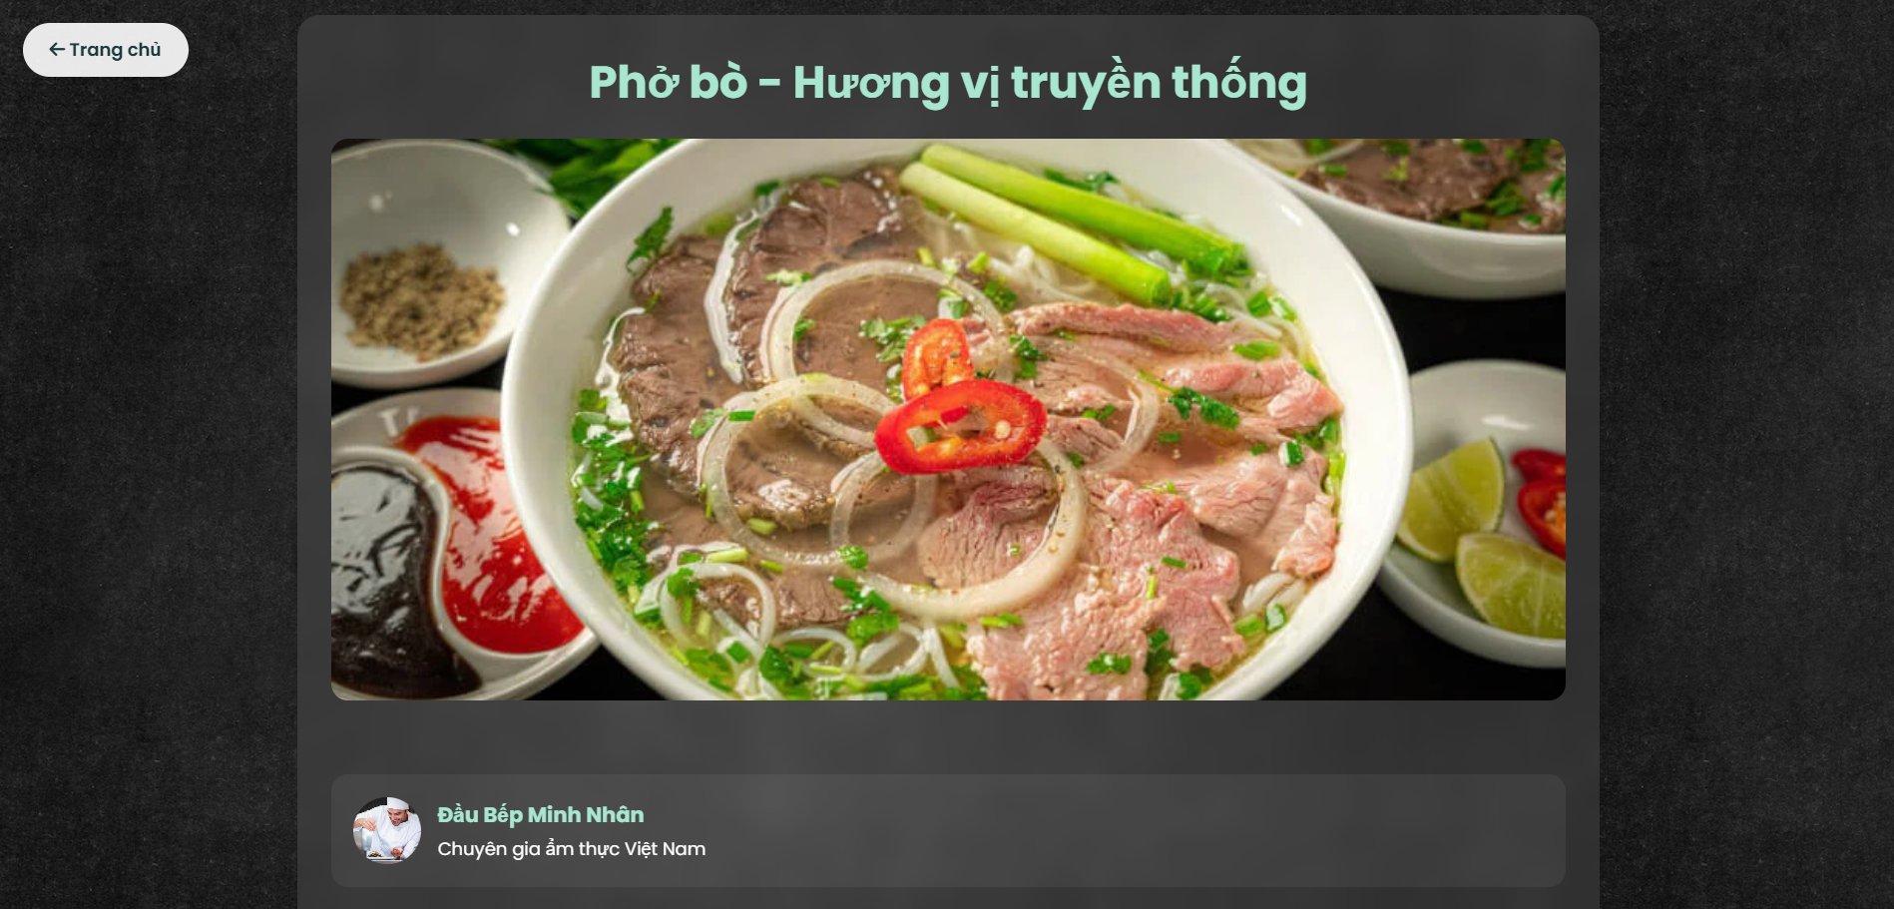
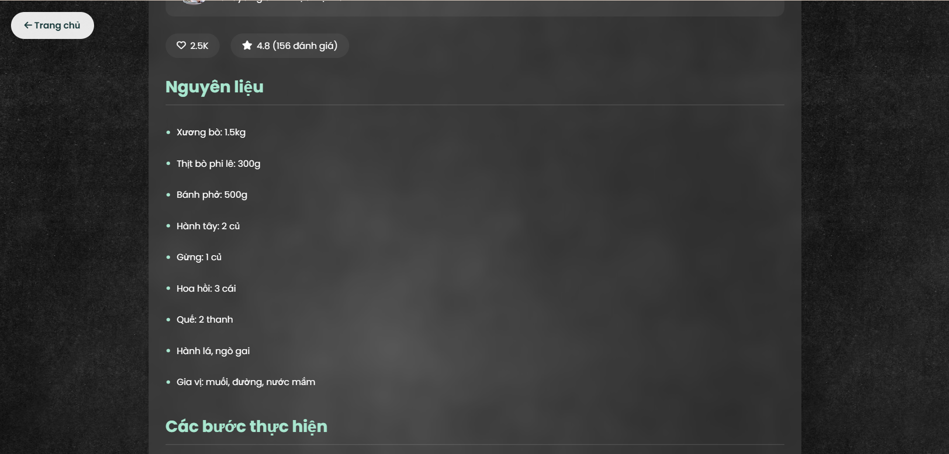
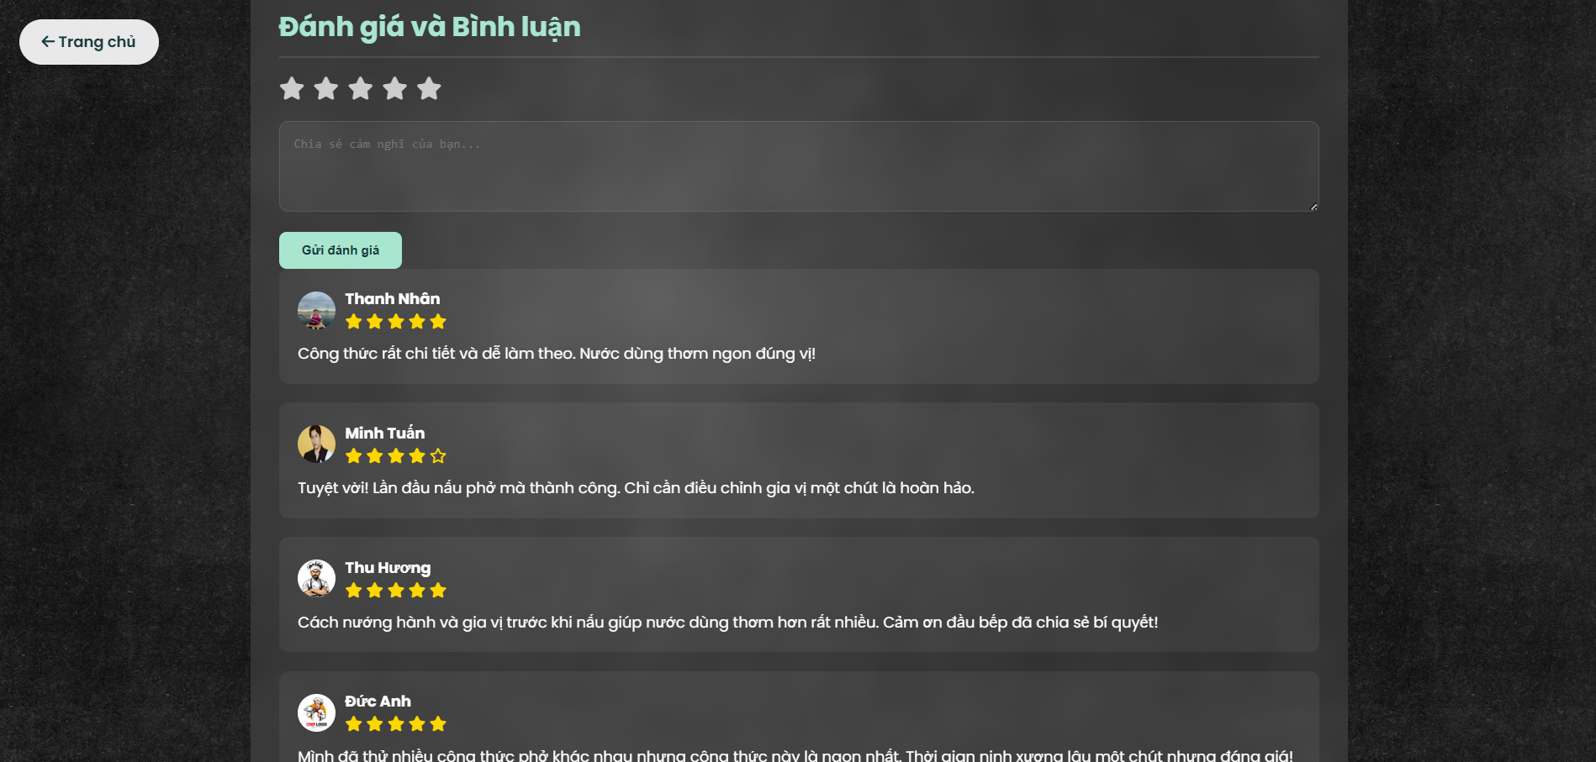
Recipe Detail Page shows recipe image, ingredients, instructions, rating, and comment sections.

Slide 13
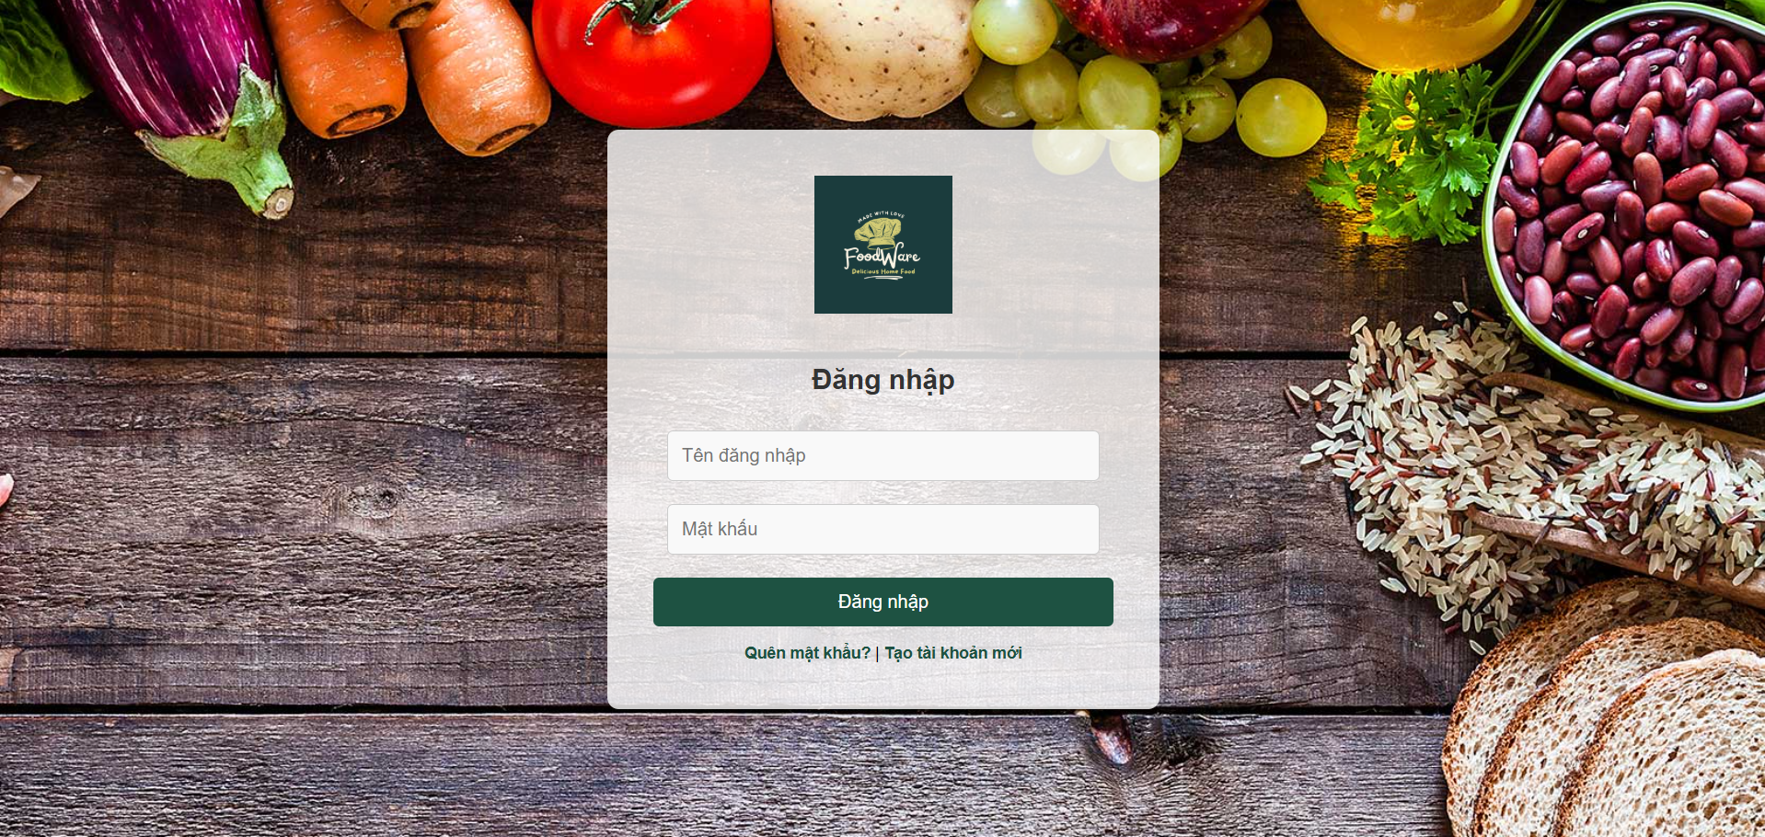
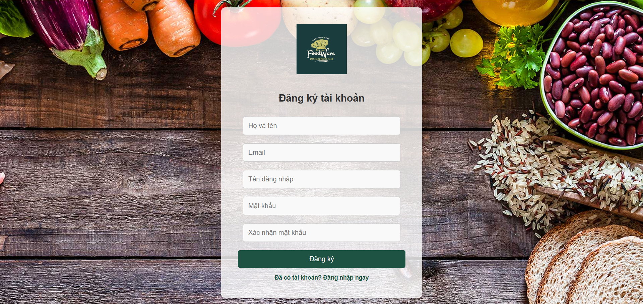
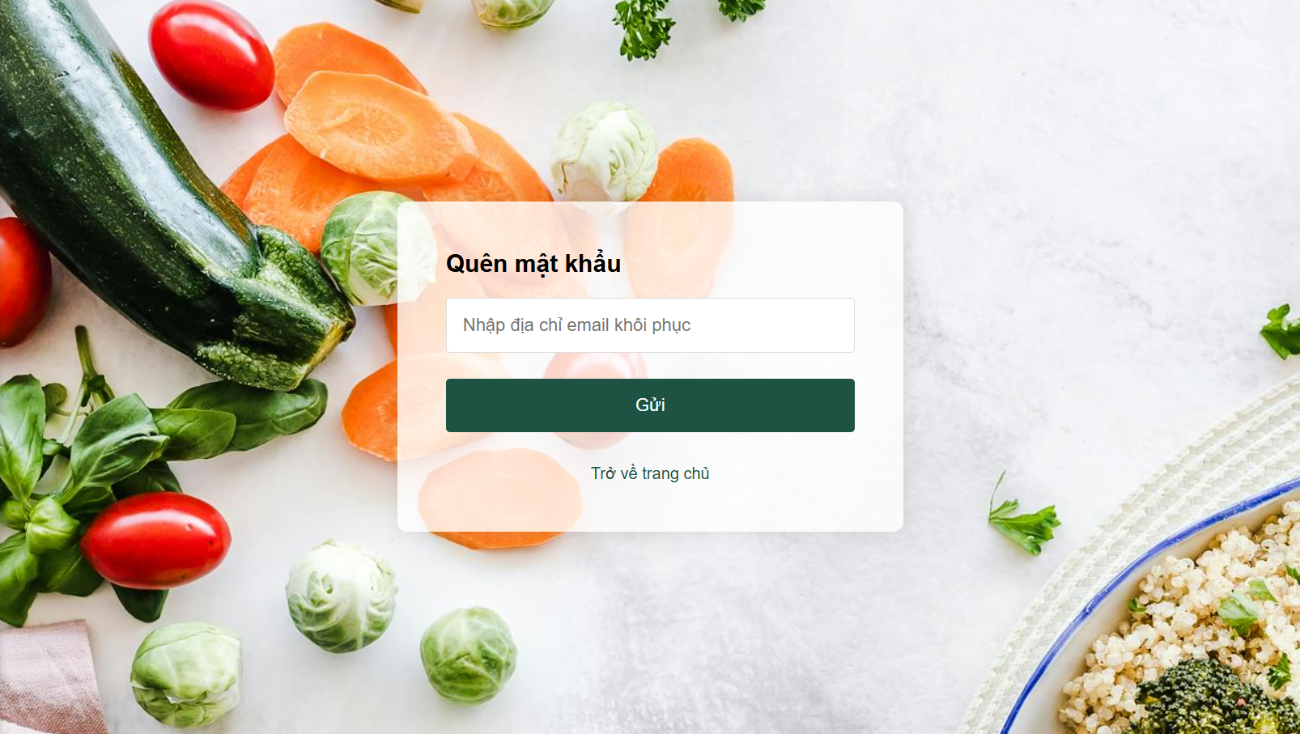
Login/Register Page allows users to log in or recover password.

Slide 14
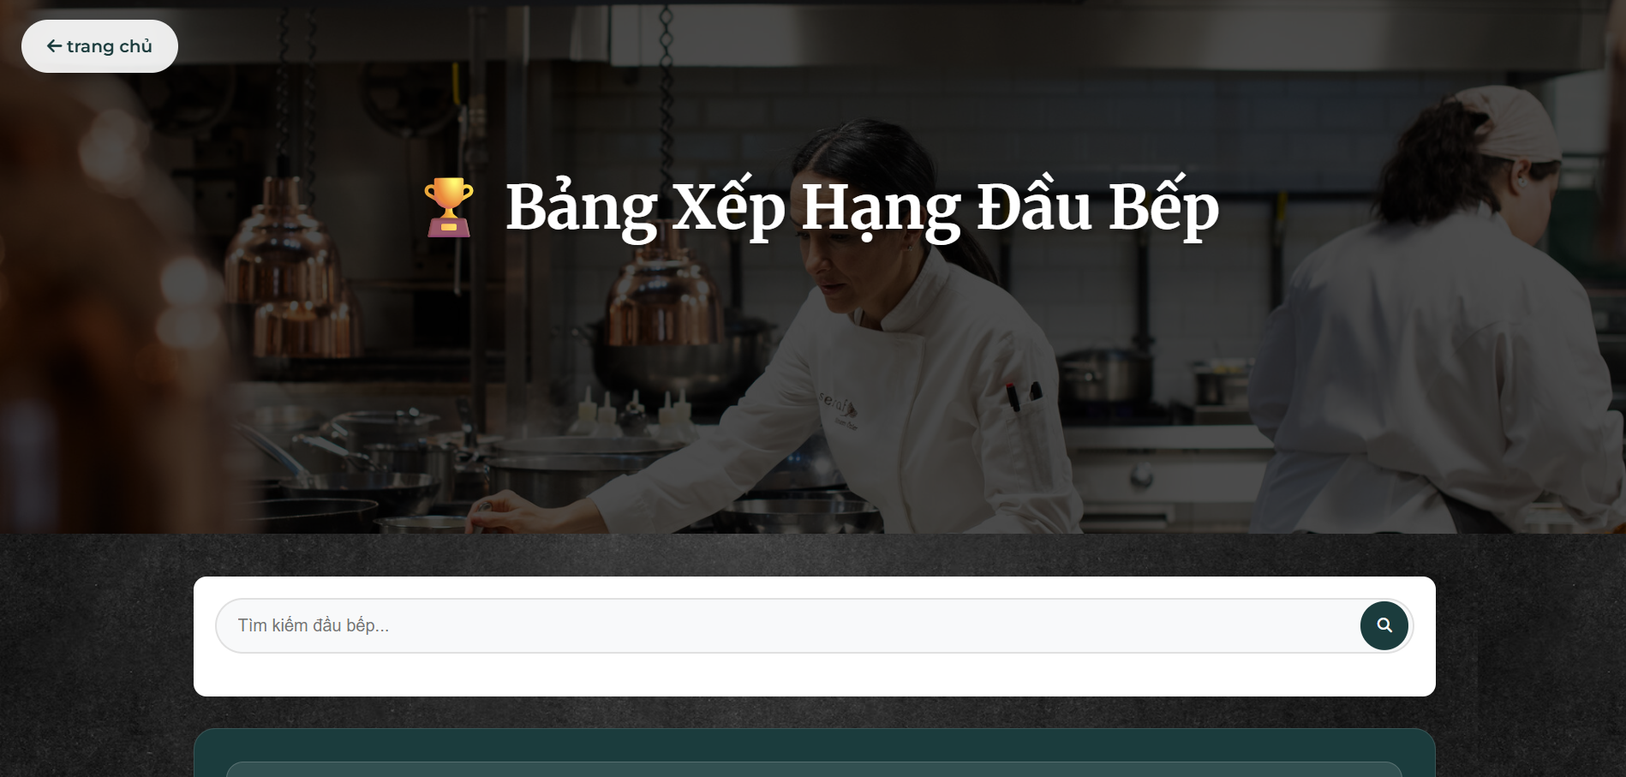
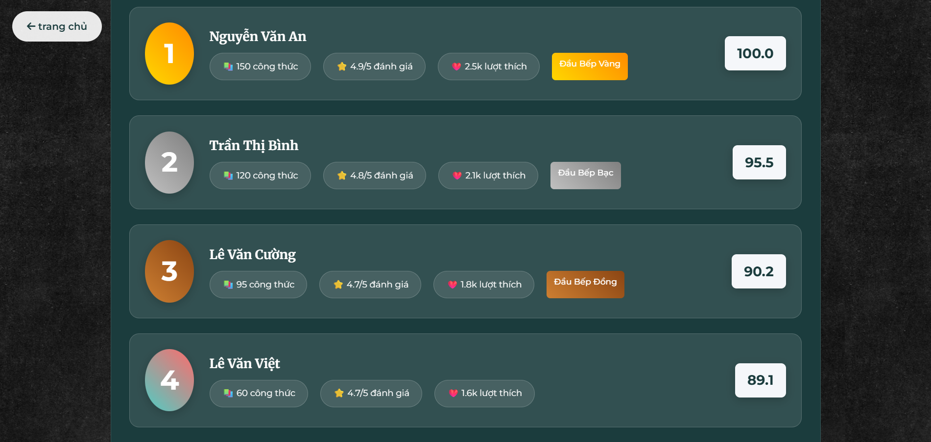
Ranking Page displays a list of top-rated recipes based on user reviews.

Slide 15
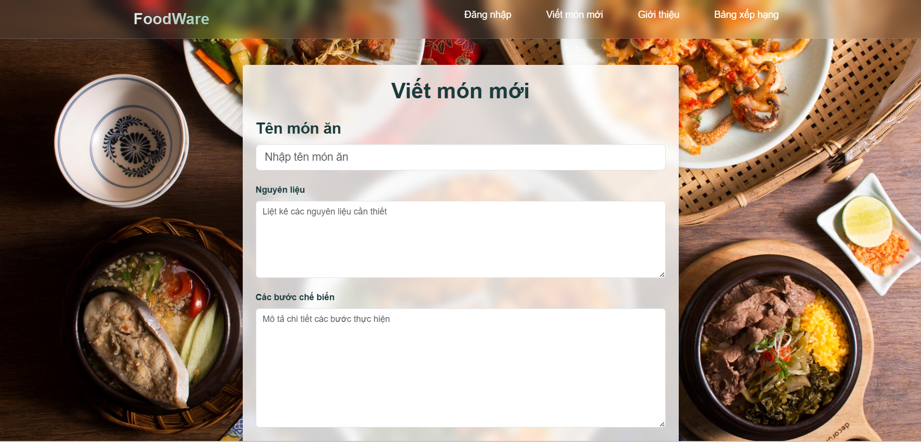
Add New Recipe Page allows users to create and share their own recipes by filling in details and uploading images.

Slide 16
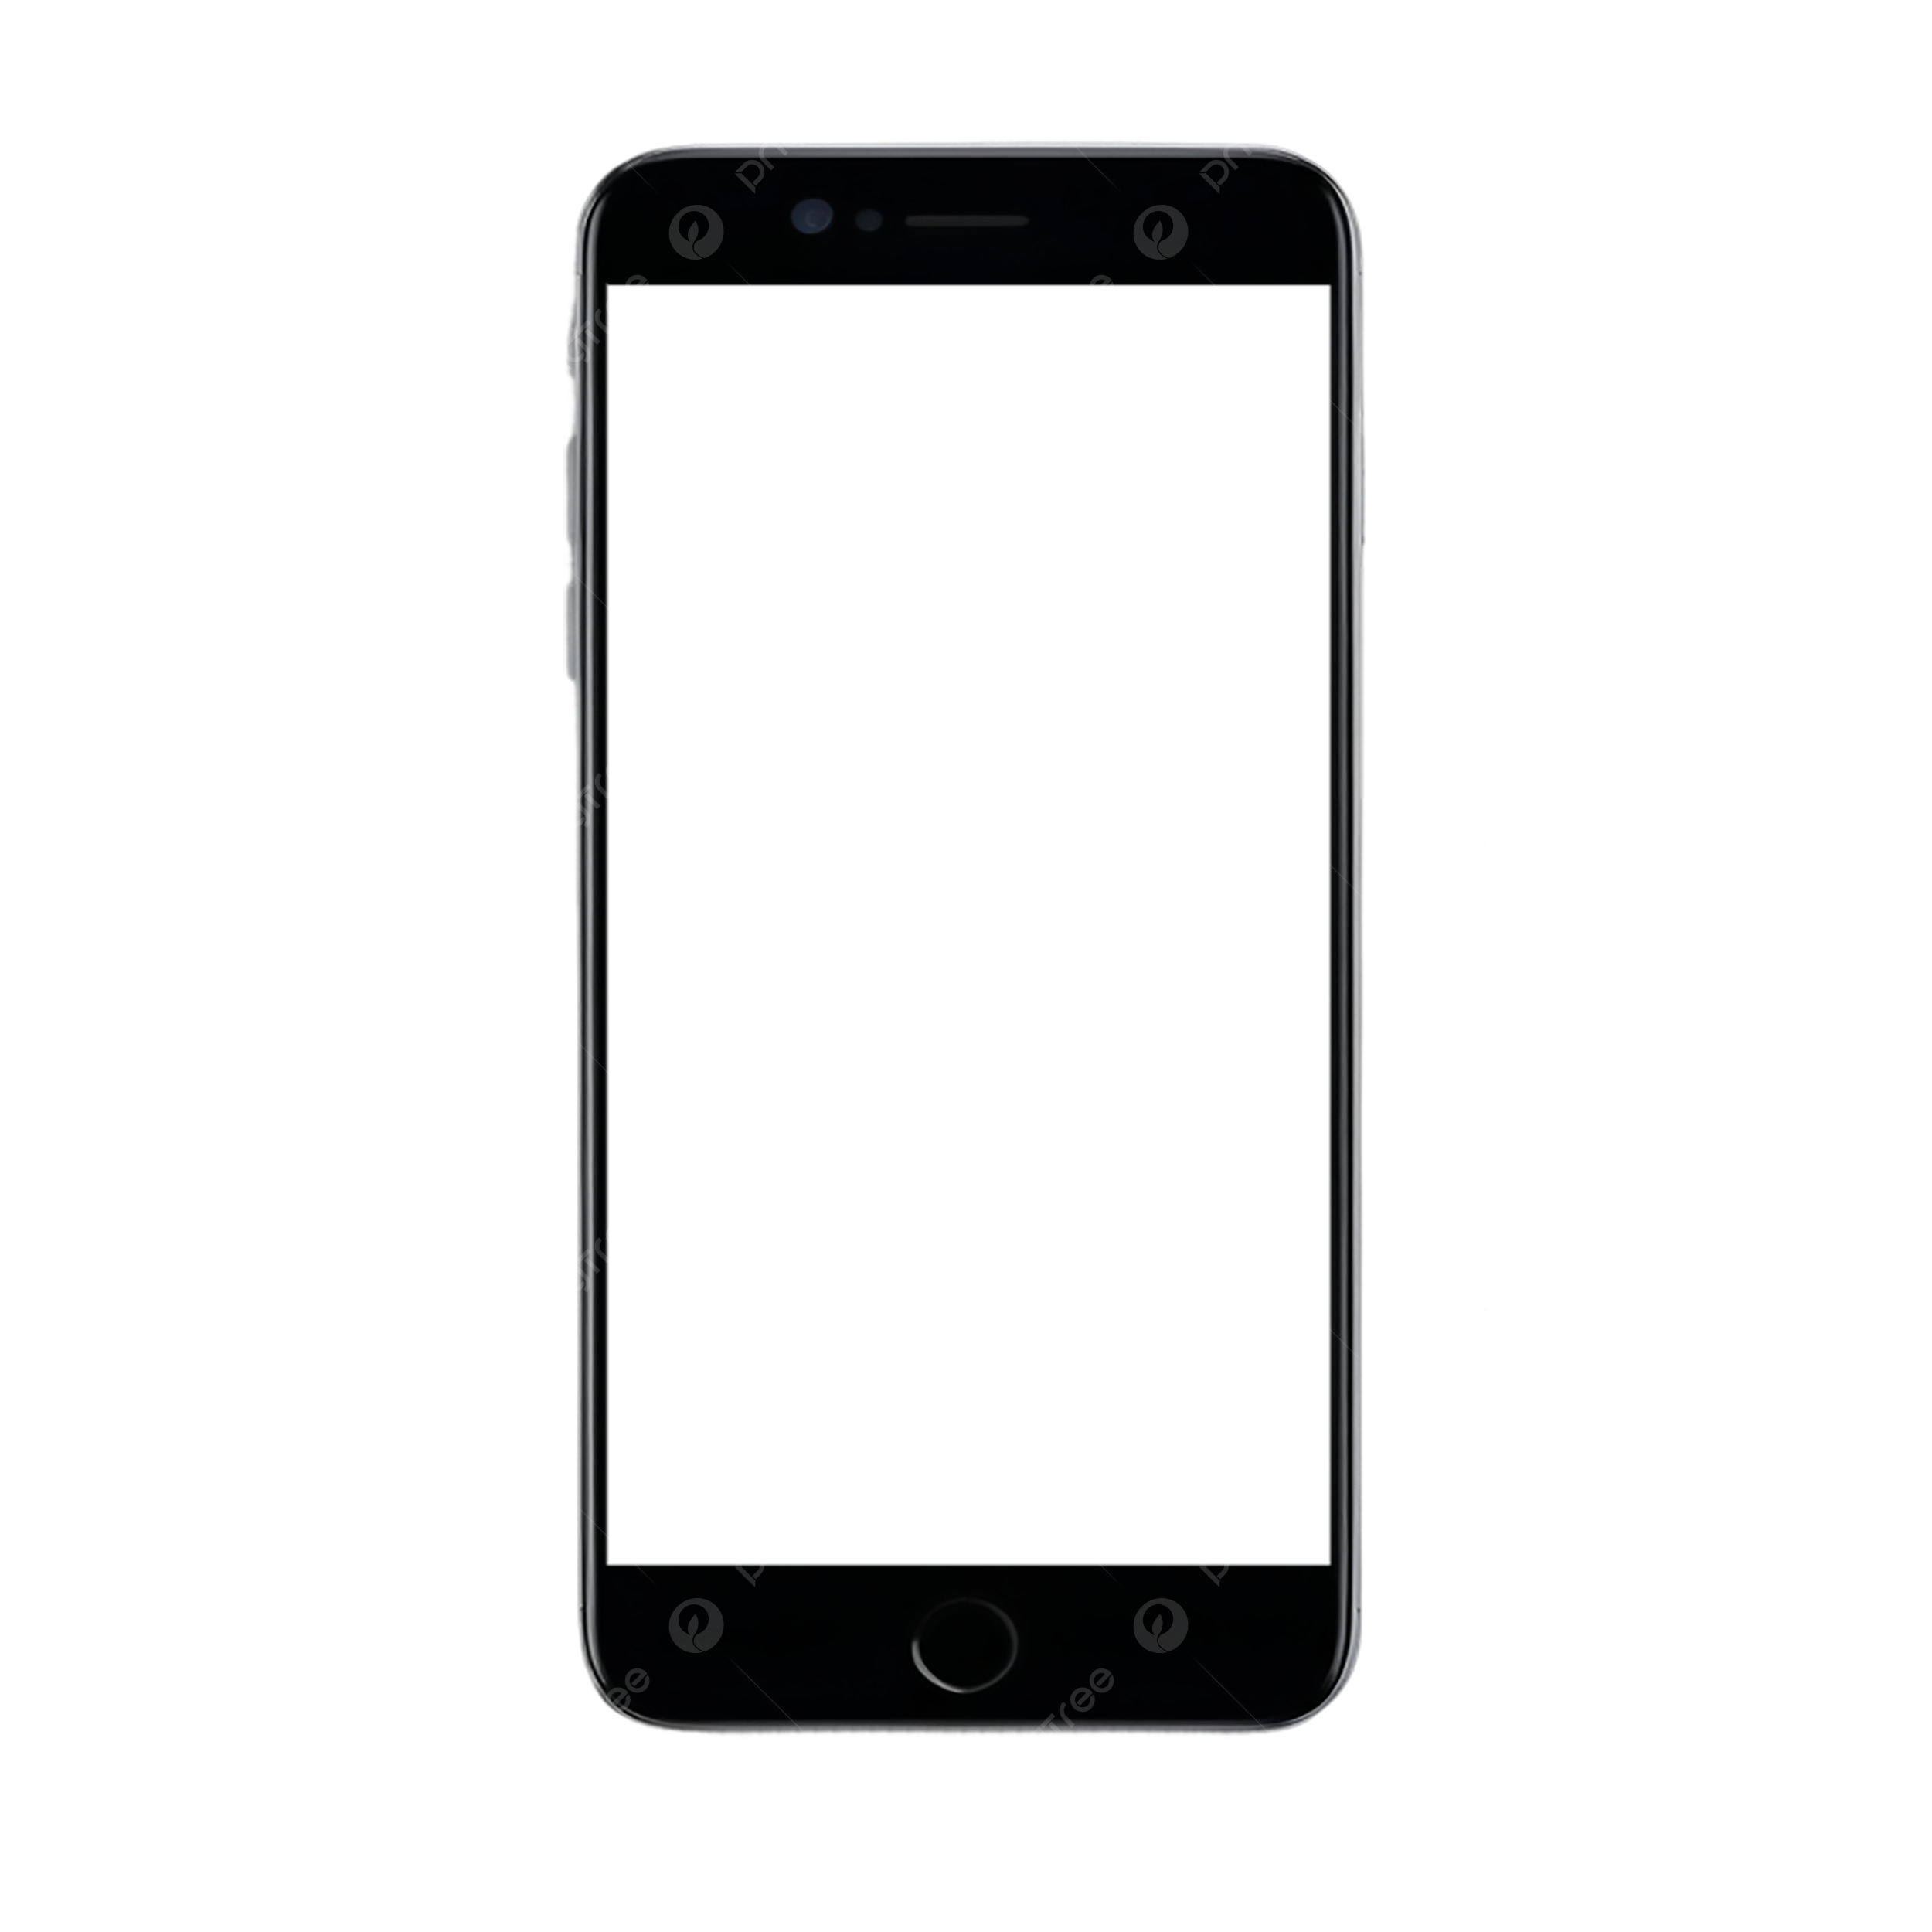
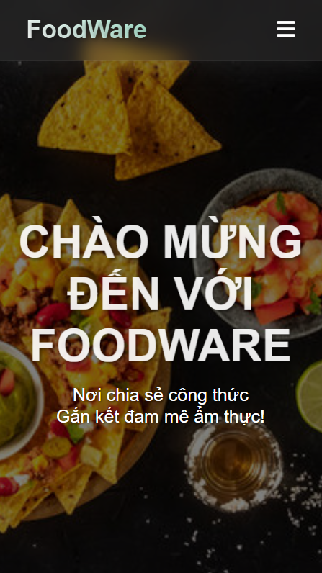
Responsive design
The website layout is optimized for both mobile and desktop, allowing users to easily view and follow recipes anytime, anywhere.

Slide 17

04
Conclusion & Future Development

Slide 18



What We Have Done
01
02
03
✅Developed the user interface for a recipe-sharing website.
✅ Completed core features: User registration & login, recipe search, recipe detail display
✅ Friendly and easy to use interface

Slide 19
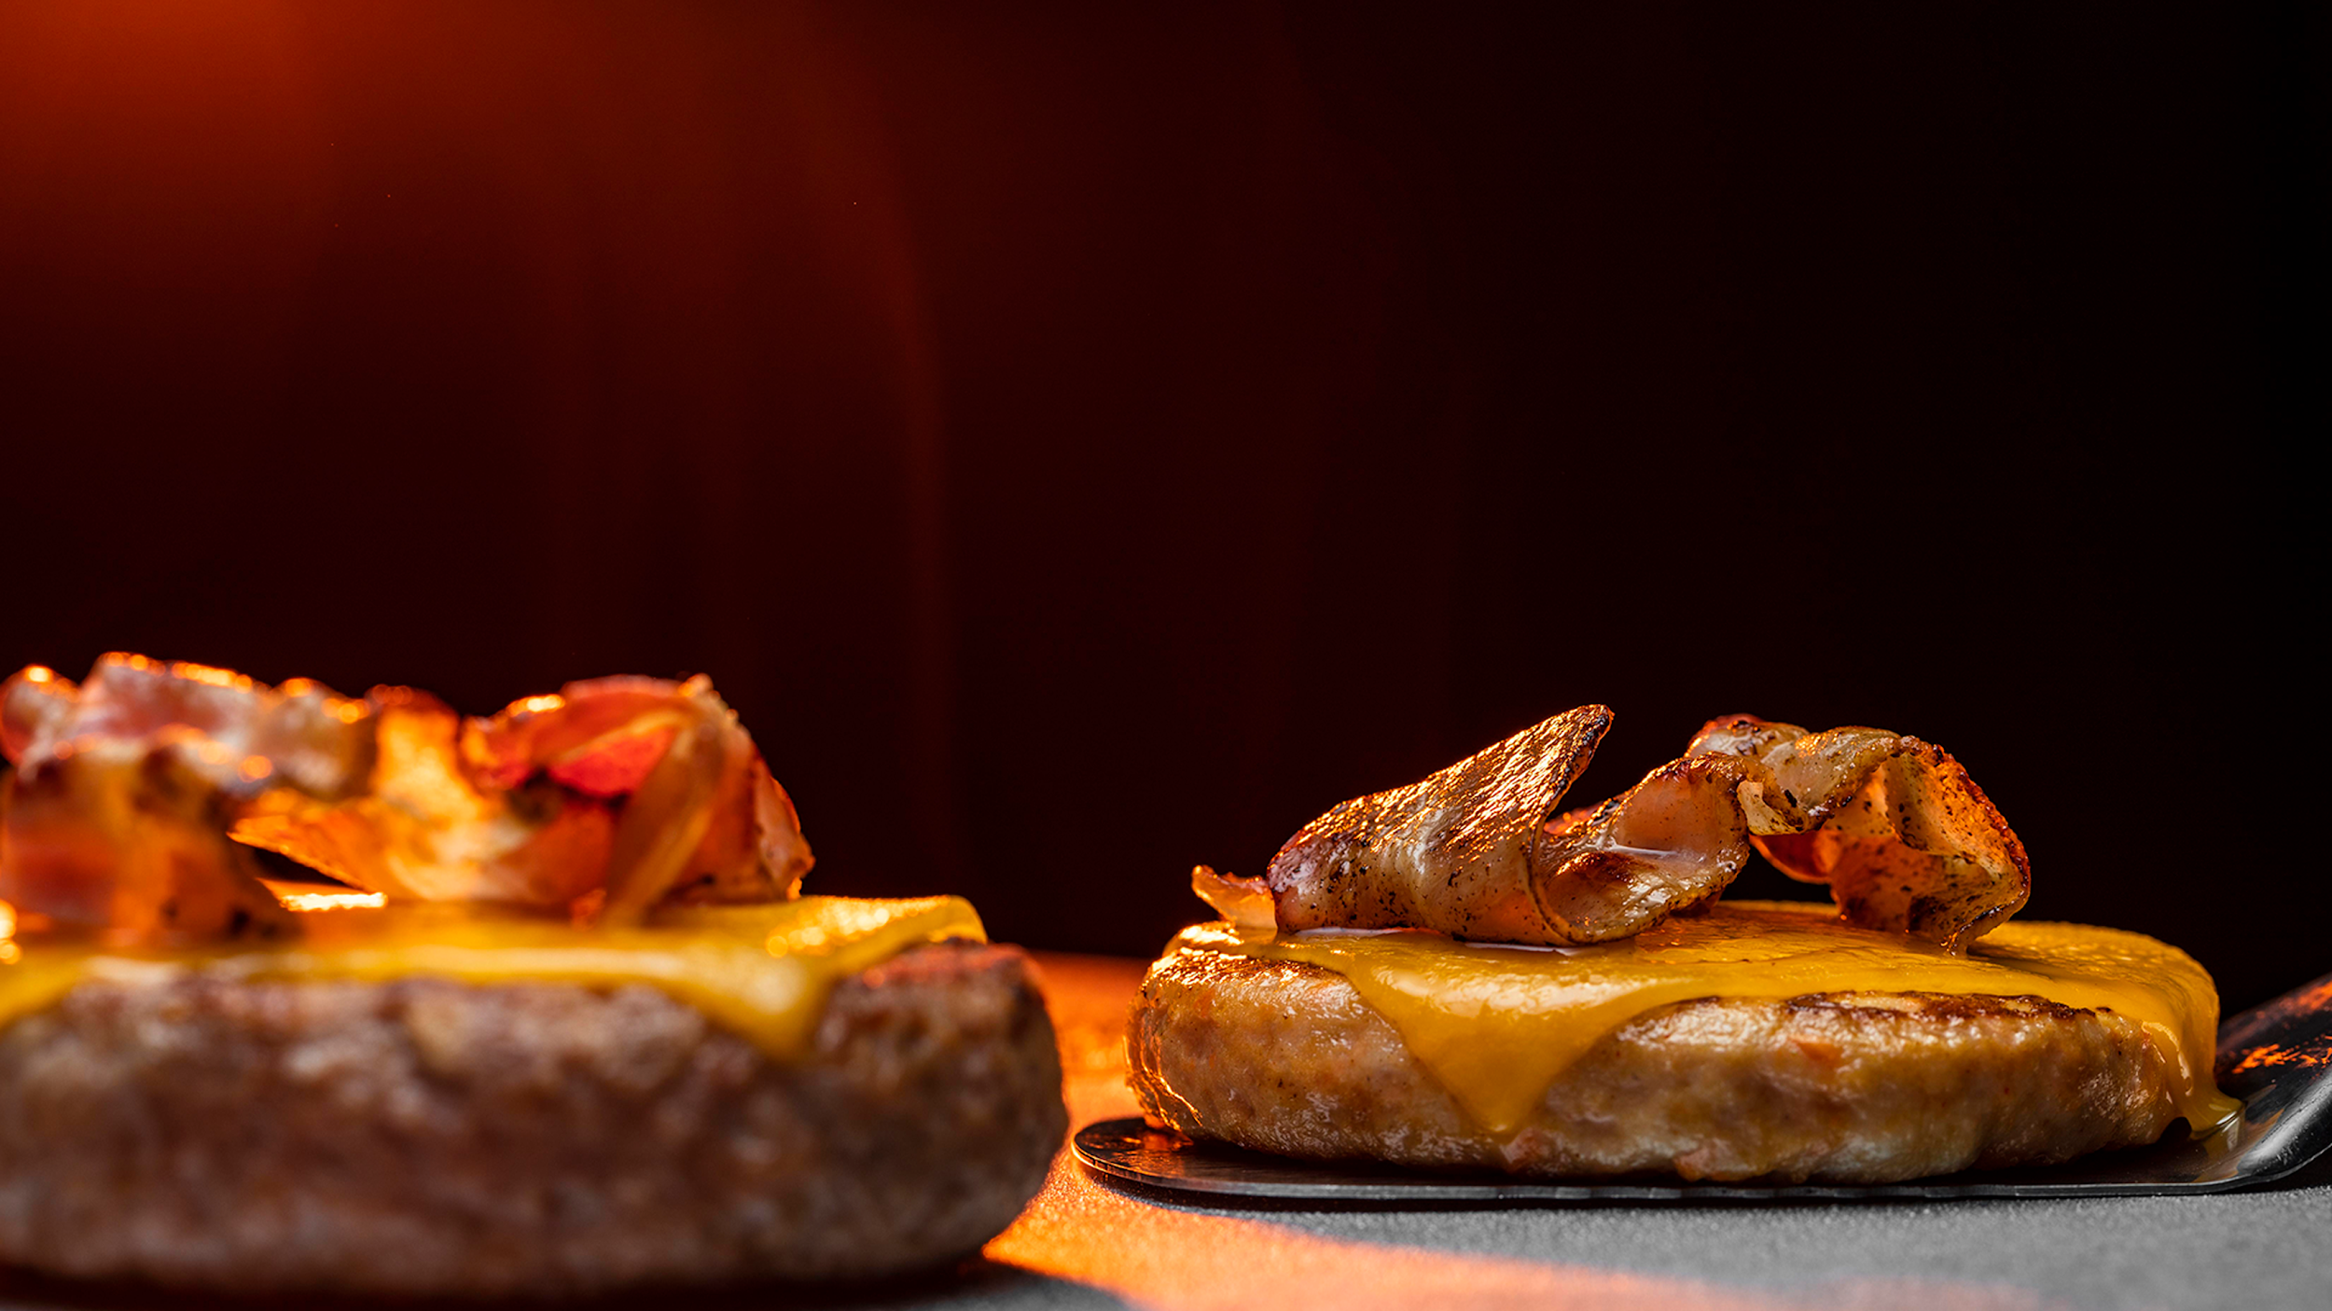

Future Development

Slide 20
Future Development
Integrate video tutorials
Use AI
Add nutrition info
Multi-language support
Classify recipes by skill level
Allow to save favorite recipes
🎥
🤖
🍎
to suggest recipes based on ingredients users have
Display calories, macros, and other health data per recipe.
For step-by-step cooking instructions
🌐
🧑‍🍳
❤️
to reach more users globally
beginner, intermediate, advanced
for quick access later

Slide 21



THANKS!

